Slide 1
Praktyczne wprowadzenie do WebSockets za pomocą Django-Channels
Michał Nakoneczny
10.10.2016

Slide 2
The Request/Response Cycle
It’s R/R all the way down:
User Agent ↔ HTTP1/2 ↔ Webserver;
Webserver ↔ WSGI ↔ Django;
Django ↔ Handler ↔ View

Slide 3
Problems
Solution
Unidirectionality: it’s always the client sending a request to the server.
Allow bi-directional communication between the client and the server.

Slide 4
Django-Channels
Runserver works automagically;
Django sessions and user auth;
Generic Consumers.

Slide 5
Consumers
Analogous to Views from the R/R-World – Receive a Request Messages and send a Response Messages

Slide 6
Channels
Channels – named FIFO task queues;
Groups – named sets of Channels.

Slide 7
Let’s make something silly.

Slide 8
ttracker/settings.py
INSTALLED_APPS = [
....,
'Channels',
...
]
ROOT_URLCONF = 'ttracker.urls'
CHANNEL_LAYERS = {
'default': {
'BACKEND': 'asgiref.inmemory.ChannelLayer',
'ROUTING': 'ttracker.routing.channel_routing',
}
}

Slide 9
Runserver magic
$ ./manage.py runserver 127.0.0.66:8000
Performing system checks...
System check identified no issues (0 silenced).
October 09, 2016 - 20:35:00
Django version 1.10, using settings 'ttracker.settings'
Starting Channels development server at http://127.0.0.66:8000/
Channel layer default (asgiref.inmemory.ChannelLayer)
Quit the server with CONTROL-C.
2016-10-09 20:35:00,535 - INFO - worker - Listening on channels http.request, websocket.connect, websocket.disconnect, websocket.receive
2016-10-09 20:35:00,536 - INFO - worker - Listening on channels http.request, websocket.connect, websocket.disconnect, websocket.receive
2016-10-09 20:35:00,536 - INFO - worker - Listening on channels http.request, websocket.connect, websocket.disconnect, websocket.receive
2016-10-09 20:35:00,537 - INFO - worker - Listening on channels http.request, websocket.connect, websocket.disconnect, websocket.receive

Slide 10
trains/models.py
class Train(models.Model):
origin_station_name = models.CharField(max_length=255)
origin_station_departure_datetime = models.DateTimeField()
destination_station_name = models.CharField(max_length=255)
destination_station_arrival_datetime =
models.DateTimeField(null=True, blank=True)

Slide 11
trains/serializers.py
class TrainSerializer(serializers.ModelSerializer):
class Meta:
model = Train
fields = ('...',)

Slide 12
trains/views.py
class TrainView(TemplateView):
template_name = 'trains/train_list.html'
class TrainAPIViewSet(ModelViewSet):
queryset = Train.objects.all()
serializer_class = TrainSerializer

Slide 13
trains/consumers.py
CHANNEL_ID = 'trains'
def ws_connect(message):
group = Group(CHANNEL_ID)
group.add(message.reply_channel)
ws_send(Train.objects.all(), channel=message.reply_channel)
def ws_send(trains, channel=None):
channel = channel or Group(CHANNEL_ID)
serialized_trains = TrainSerializer(trains, many=True).data
channel.send({'text': json.dumps(serialized_trains)})
def ws_disconnect(message):
Group(CHANNEL_ID).discard(message.reply_channel)

Slide 14
ttracker/router.py
ttracker/urls.py
from trains.views import TrainAPIViewSet
router = DefaultRouter()
router.register(r'trains', TrainAPIViewSet)
from .router import router
urlpatterns = [
url(r'^$', RedirectView.as_view(...)),
url(r'^trains/', include('trains.urls', ...)),
url(r'^api/', include(router.urls, ...)),
url(r'^admin/', admin.site.urls),
]

Slide 15
ttracker/routing.py
from channels.routing import route
from trains.consumers import (ws_connect, ws_receive, ws_disconnect)
channel_routing = [
route('websocket.connect', ws_connect),
route('websocket.receive', ws_receive),
route('websocket.disconnect', ws_disconnect)
]

Slide 16
trains/signals.py
from .consumers import ws_send
@receiver(post_save)
def post_save_ws_send(sender, **kwargs):
instance = kwargs['instance']
ws_send([instance])

Slide 17
js/app.js
var app = angular.module('ttrackerApp', []);
app.controller('tableCtrl', function ($scope, $http) {
//...
$scope.sendTrain = function () {
$http.post('/api/trains/', $scope.newTrain).then(function (response) {
$scope.clientTrains.push(response.data);
$scope.newTrain = {};
});
};
$scope.getTrains = function () {
$http.get('/api/trains/').then(function (response) {
$scope.clientTrains = response.data;
});
};
//...
});

Slide 18
js/app.js
var app = angular.module('trainApp', []);
app.controller('tableCtrl', function ($scope, $http) {
//...
var ws = new WebSocket("ws://" + location.host);
ws.onmessage = function (message) {
$scope.$apply(function () {
var data = JSON.parse(message.data);
$scope.trains = $scope.trains.concat(data);
});
};

Slide 19
Production environment
Setup channel backend: in-memory, POSIX IPC, Redis;
asgiref.inmemory.ChannelLayer
asgi_ipc.IPCChannelLayer
asgi_redis.RedisChannelLayer

Slide 20
Production environment
Setup channel backend: in-memory, POSIX IPC, Redis;
Run worker servers:
python manage.py runworker

Slide 21
Production environment
Setup channel backend: in-memory, POSIX IPC, Redis;
Run worker servers;
Run interface servers

Slide 22
wsgi.py
asgi.py
import os
from django.core.wsgi import get_wsgi_application
os.environ.setdefault("DJANGO_SETTINGS_MODULE", "ttracker.settings")
application = get_wsgi_application()
import os
from channels.asgi import get_channel_layer
os.environ.setdefault("DJANGO_SETTINGS_MODULE", "ttracker.settings")
channel_layer = get_channel_layer()

Slide 23
Production environment
Setup channel backend: in-memory, POSIX IPC, Redis;
Run worker servers;
Run interface servers (alone or alongside WSGI):
daphne ttracker.asgi:channel_layer

Slide 24
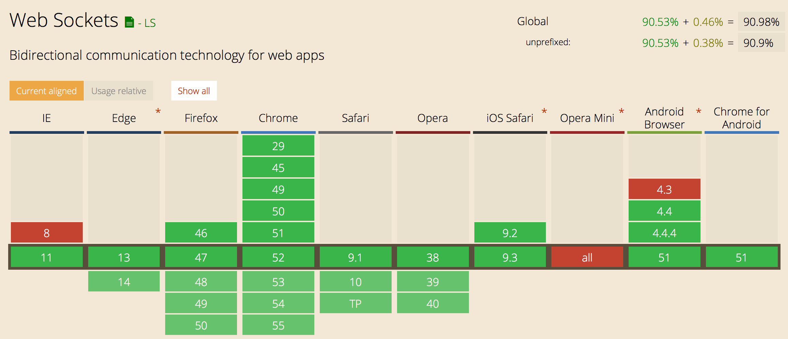
Can I use?

Slide 25
Some gotchas
Improperly formatted messages hang Daphne;
Client-side reloads close and reopen sockets, but server-side reloads close connection. You need to reopen from the client side;
$scope.$apply(...);
Nginx: pass the Upgrade: WebSocket header, otherwise you will get 404s difficult to debug.

Slide 26
Thanks!
Questions?

